Slide 1

Project on MySQL
Grocery Store Management

Slide 2

Introduction
The Retail and Grocery domain requires effective management of inventory, suppliers, customer orders, employees, and product categories.
Efficient data handling helps businesses track sales and revenue, monitor product availability, and analyze operations.
This project simulates a mini grocery store database with interconnected entities like products, orders, and suppliers.
It offers hands-on experience in understanding data relationships and operational workflows.
Students will use SQL to extract and transform data, gaining valuable business insights.
The goal is to improve decision-making and operational efficiency through data analysis.

Slide 3
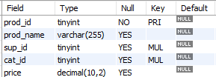



Tables
Products Table
Customers Table
Suppliers Table
Categories Table

Slide 4


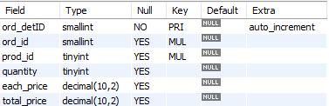
Tables
Employees Table
Order Details Table
Orders Table

Slide 5
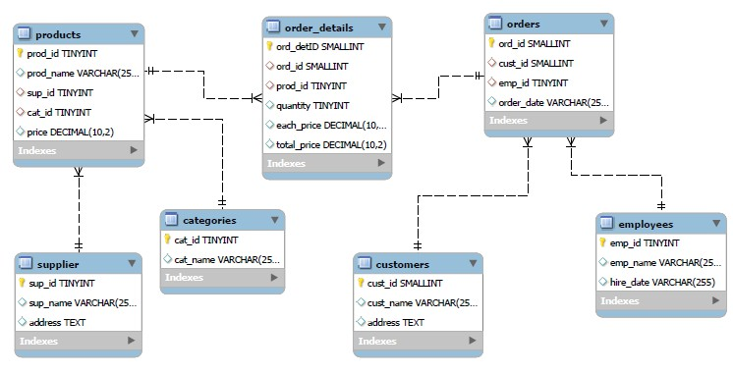
ER Diagram

Slide 6
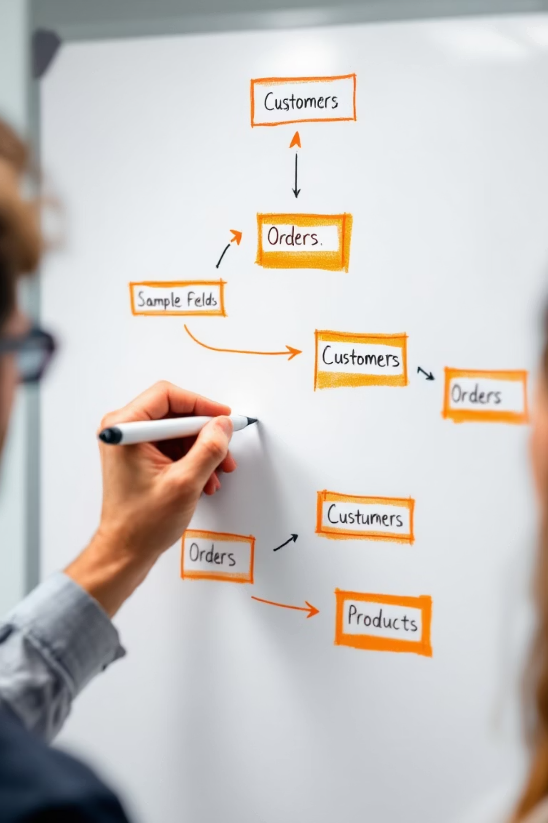
Problem Statement
In the dynamic environment of a retail grocery store, managing and analyzing large volumes of data related to products, suppliers, customers, and orders is crucial for efficient operations and informed decision-making.
This project aims to design and implement a relational database system that captures essential store activities and enables users to retrieve and analyze data through SQL.
The system will support complex queries to identify key business insights such as top-performing products, high-value customers, and revenue patterns, while reinforcing practical SQL skills including joins, aggregations, subqueries, and filtering.

Slide 7
1️. Customer Insights

Slide 8


Q1.1. How many unique customers have placed orders?
Query :-
Output :-

Slide 9
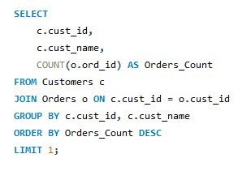

Q1.2. Which customers have placed the highest number of orders?
Query :-
Output :-

Slide 10
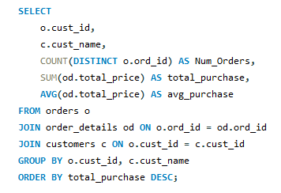
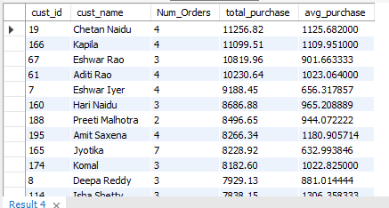
Q1.3. What is the total and average purchase value per customer?
Query :-
Output :-

Slide 11
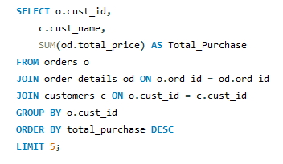
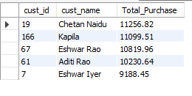
Q1.4. Who are the top 5 customers by total purchase amount?
Query :-
Output :-

Slide 12
2. Product Performance

Slide 13
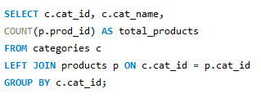
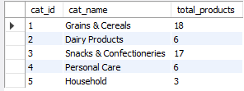
Q2.1. How many products exist in each category?
Query :-
Output :-

Slide 14
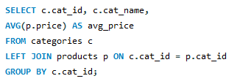
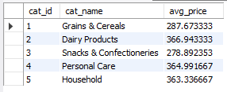
Q2.2. What is the average price of products by category?
Query :-
Output :-

Slide 15
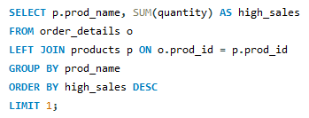

Q2.3. Which products have the highest total sales volume (by quantity)?
Query :-
Output :-
:-

Slide 16

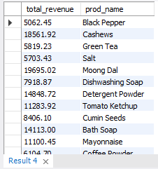
Q2.4. What is the total revenue generated by each product?
Query :-
Output :-

Slide 17
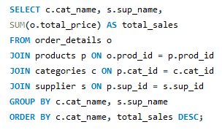
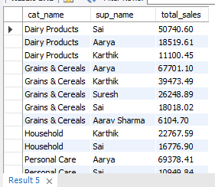
Q2.5. How do product sales vary by category and supplier?
Query :-
Output :-

Slide 18
3. Sales and Order Trends

Slide 19


Q3.1. How many orders have been placed in total?
Query :-
Output :-

Slide 20


Q3.2. What is the average value per order?
Query :-
Output :-

Slide 21
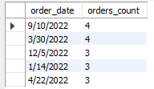
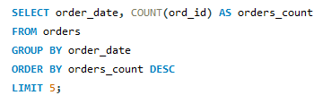
Q3.3. On which dates were the most orders placed?
Query :-
Output :-

Slide 22
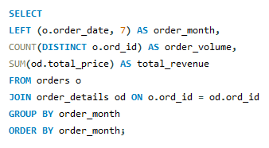
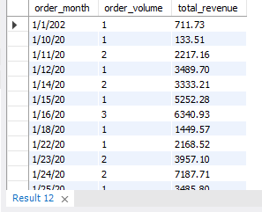
Q3.4. What are the monthly trends in order volume and revenue?
Query :-
Output :-

Slide 23
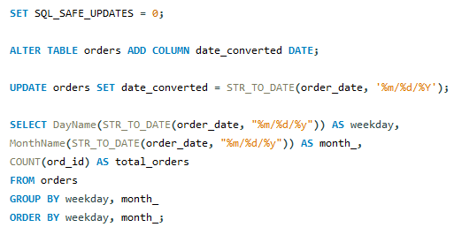
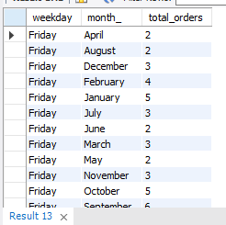
Q3.5. How do order patterns vary across weekdays and weekends?
Query :-
Output :-

Slide 24
4️. Supplier Contribution

Slide 25


Q4.1. How many suppliers are there in the database?
Query :-
Output :-

Slide 26
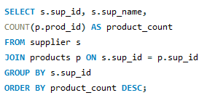
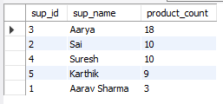
Q4.2. Which supplier provides the most products?
Query :-
Output :-

Slide 27
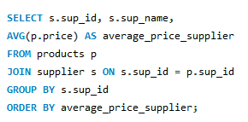
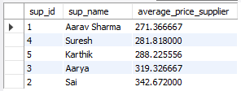
Q4.3. What is the average price of products from each supplier?
Query :-
Output :-

Slide 28
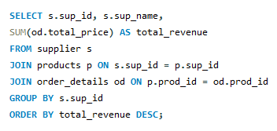
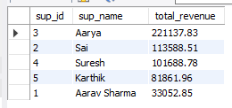
Q4.4. Which suppliers contribute the most to total product sales (by revenue)?
Query :-
Output :-

Slide 29
5️. Employee Performance

Slide 30


Q5.1. How many employees have processed orders?
Query :-
Output :-

Slide 31
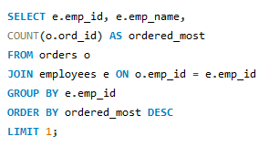

Q5.2. Which employees have handled the most orders?
Query :-
Output :-

Slide 32
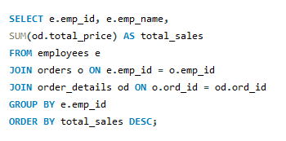
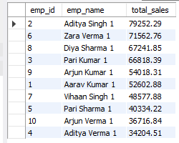
Q5.3. What is the total sales value processed by each employee?
Query :-
Output :-

Slide 33
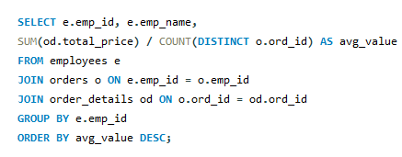
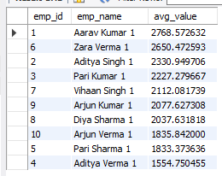
Q5.4. What is the average order value handled per employee?
Query :-
Output :-

Slide 34
6️. Order Details Deep Dive

Slide 35
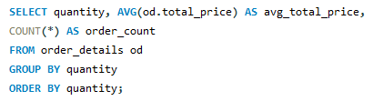
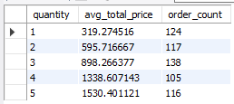
Q6.1. What is the relationship between quantity ordered and total price?
Query :-
Output :-

Slide 36
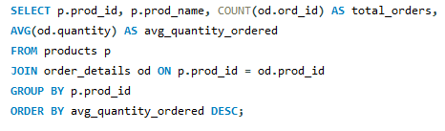
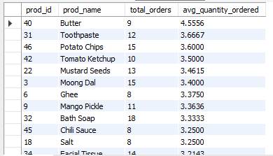
Q6.2. What is the average quantity ordered per product?
Query :-
Output :-

Slide 37
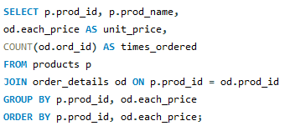
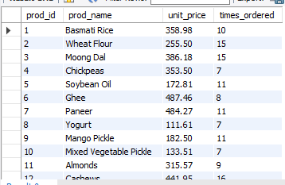
Q6.3. How does the unit price vary across products and orders?
Query :-
Output :-

Slide 38

CONCLUSION
This project demonstrates how a relational database can efficiently manage and analyse grocery store operations.
It provides structured data storage through linked tables for products, orders, suppliers, customers, and employees.
SQL queries help uncover insights on sales, customer behaviour, and supplier or employee performance.
These insights support better decision-making, improving efficiency and overall store performance.

Slide 39

THANK YOU

